Slide 1
9- For..Else

Slide 2
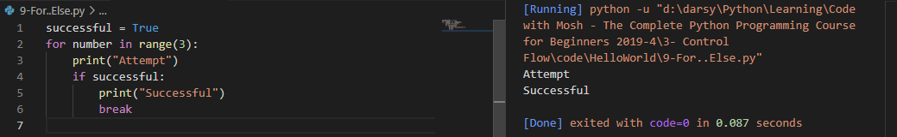

Slide 3
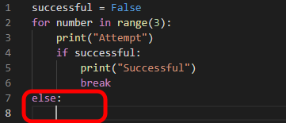
What we put under this else statement will only be executed if this loop completes without an early termination.
So if we never break out of this loop, then the else statement will be executed.

Slide 4
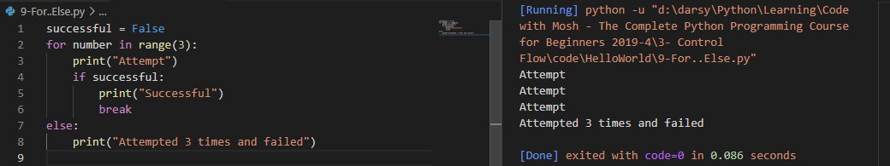

Slide 5
